Slide 1
Futures Market
By György Czipó
Notes:
Introduction:

Slide 2
Derivatives
A derivative is a financial contract which derives its value from the performance of another entity such as a currency, an asset, index, or interest rate, called the "underlying"
The distinguishing characteristic of derivatives is the leverage they offer. The value of a position, which a derivative represents is far greater than the down payment made by the trader. This leverage makes derivatives cost effective in a positive sense and risky in a negative sense.

Slide 3
Derivative Instruments
Forward contracts (Forwards)
Futures contract (Futures)
Options
Swaps
Remember: The underlying assets of these derivatives can be: currency, commodity, stocks, index, etc.

Slide 4
Futures and Forwards
Forward - an agreement between a bank/financial institution and a customer to deliver a specified amount of an asset (stock, currency) at an agreed-upon price in a agreed date in the future. Traded OTC.
Futures - similar to forward but has standardized terms and is traded on an exchange.
Key difference in futures
Futures have organized secondary market trading (higher liquidity)
Marked to market (pricing)
Standardized contract terms such as delivery dates, price units, contract size
Clearinghouse guarantees performance (lower counterparty risk)

Slide 5
EXCHANGES VS. OTC
Exchanges
Advantages
Clearinghouse involved
Higher liquidity
Standardization (contract size,
settlement date, )
Disadvantages
Lack of flexibility
Regulation
Higher Trading costs
Trading information is public
OTC Markets
Disadvantages
Counterparty risk
Low liquidity
Non-standardization
Advantages
Flexible (tailor-made)
Less regulation
Lower costs
Trading information private

Slide 6
Forward vs. Futures
A futures contract is like a forward contract:
It specifies that a certain product (currency, commodity, stock) will be exchanged for another at a specified time in the future at prices specified today.
A futures contract is different from a forward contract:
Futures are standardized contracts trading on organized exchanges with daily resettlement through a clearinghouse.

Slide 7
Example Currency Forward: Advantages and Disadvantages
Contracts written by market maker banks to the “specifications” of the global firm.
For some exact amount of a foreign currency.
For some specific date in the future.
No upfront fees or commissions.
Bid and Ask spreads produce round transaction profits.
Global firm knows exactly what the home currency equivalent of a fixed amount of foreign currency will be in the future.
However, global firm cannot take advantage of a favorable change in the foreign exchange spot rate.

Slide 8
Futures specification
Quality and quantity of the product
The Futures price: agreed-upon price paid at maturity
Settlement date, place: pre-agreed financial settlement of the the transaction in the future point of time and place
Long position: Agrees to purchase the underlying asset at the stated futures price at contract maturity
Short position: Agrees to deliver the underlying asset at the stated futures price at contract maturity
Profits on long and short positions at maturity
Long = Futures price at maturity minus original futures price
Short = Original futures price minus futures price at maturity
At contract maturity T: F_{T}= S_{T} F = Futures price, S = spot price
Notes:
The book says spot price at maturity and this is correct due to convergence between the futures and the spot price at maturity.

Slide 9
Types of Contracts
Agricultural commodities (corn, rise)
Metals and energy (gold, copper, oil, natural gas, power, etc)
Financial futures
Interest rate futures
Stock index futures
Foreign currencies

Slide 10
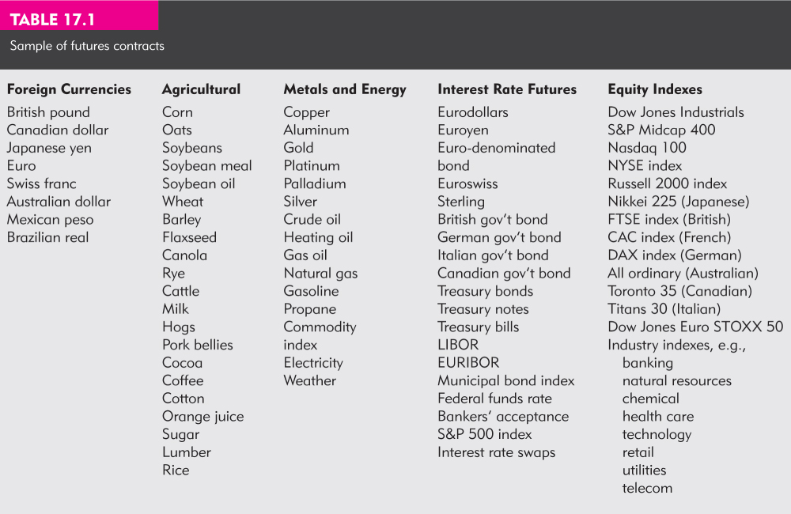
Sample of Futures Contracts

Slide 11
The Forward Rate as a Predictor
Because the forward rate is determined by the supply of and demand for the future delivery of a product, it may convey information about the future spot rate.
Many empirical studies indicate that there is some co-movement between the forward and spot rate.
The co-movement is less than one-to-one; thus the forward rate has limited ability in forecasting the future spot exchange rate.

Slide 12
Forward discount vs. premium
FD (forward discount)
If the forward rate is below the present spot price, the product (currency, index, stock, commodity) is said to be at a forward discount with respect to the domestic product.
FP (forward premium)
If the forward rate is above the present spot rate, the product is said to be at a forward premium with respect to the domestic product.

Slide 13
The Clearinghouse and Open Interest
Clearinghouse - acts as a party to all buyers and sellers.
Why do we need a clearing house?
A futures participant is obligated to make or take delivery at contract maturity
Methods closing out positions
Reversing the trade
Take or make delivery
Most trades are reversed and do not involve actual delivery
Open Interest
The number of contracts opened that have not been offset with a reversing trade: measure of future liquidity
Notes:
Avoiding delivery: It is common to have your broker automatically close out your position on the last trading day before delivery becomes an obligation, or to roll your contract over to the next closest expiration contract. Over 90% of futures contracts do not result in delivery. For stock index contracts, the contracts are cash settled only and no delivery can take place. Why this doesn’t really matter is explained after the marking to market example.

Slide 14
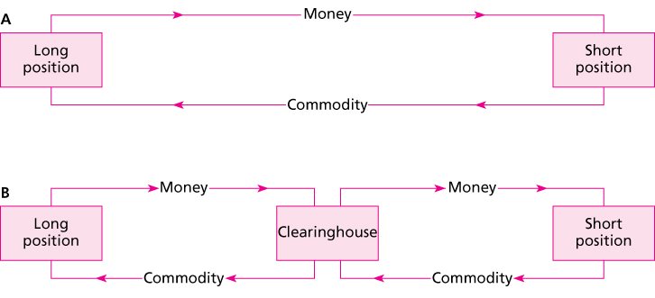
Clearinghouse
The clearinghouse eliminates counterparty default risk; this allows anonymous trading since no credit evaluation is needed. Without this feature you would not have liquid markets.
Notes:
The clearinghouse eliminates counterparty default risk; this allows anonymous trading since no credit evaluation is needed. Without this feature you would not have liquid markets.

Slide 15
Forward/Futures Pricing
Spot-futures parity theorem
Purchase the commodity now and store it to T,
Simultaneously take a short position in futures,
The ‘all in cost’ of purchasing the commodity and storing it (including the cost of funds) must equal the futures price to prevent arbitrage.

Slide 16
More on futures contracts
Convergence of Price: As maturity approaches the spot and futures price converge
Delivery: Specifications of when and where delivery takes place and what can be delivered
Cash Settlement: Some contracts are settled in cash rather than delivering the underlying assets

Slide 17
The no arbitrage condition
Since the strategies have the same flows at time T they must cost the same:
F₀ / (1 + r_{f})^{T} = S₀
F₀ = S₀ (1 + r_{f})^{T}
The futures price differs from the spot price by the cost of carry.
Can the cost of carry be negative?
Notes:
This is an alternative development that is in the text. It is not as intuitive however. An arbitrage argument illustrates the point. First, the only cost of carry here is the time value of money represented by the risk free rate, so we are ignoring any physical storage cost of the gold. One could borrow the money (that is the invest in bills part) to buy the spot commodity, buy the spot and concurrently short the futures.

Slide 18
Basis and Basis Risk
Basis - the difference between the futures price and the spot price
A hedger exchanges spot price risk for basis risk.
Basis is more stable than the spot price
At contract maturity the basis declines to zero.
Basis Risk - the variability in the basis that will affect hedging performance

Slide 19
Trading Strategies
Speculation
Go short futures in if you believe price will fall
Go long futures if you believe price will rise
Hedging
Long hedge: A fund will purchase stock in 3 months. The manager buys futures now to protect against a rise in price.
Short hedge: A hedge fund has invested in long term bonds and is worried that interest rates may increase. Could sell futures to protect against a fall in price.

Slide 20
Hedging
Future price quotes -real time
What is hedging?
As key advantage hedging insures a steady (fix) stream of revenu the company will not be impacted by an unfortunate price change of the product in the future.
As a disadvantage hedging has a trading cost.
By hedge we will be protected, but we will give up the opportunity to gain more on the possible price move. We will not lose, but surely will not benefit for a future price movement of the product.
If we not hedge our outstanding position we are speculating!
Notes:
Avoiding delivery: It is common to have your broker automatically close out your position on the last trading day before delivery becomes an obligation, or to roll your contract over to the next closest expiration contract. Over 90% of futures contracts do not result in delivery. For stock index contracts, the contracts are cash settled only and no delivery can take place. Why this doesn’t really matter is explained after the marking to market example.

Slide 21
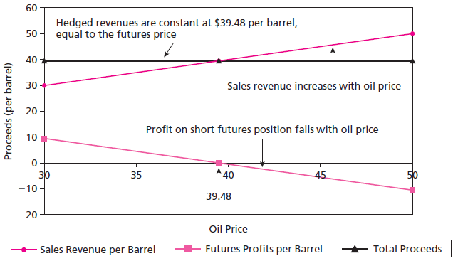
Hedging Revenues Using Futures

Slide 22
Marking to Market and the Margin Account
Initial Margin: funds that must be deposited in a margin account to provide capital to absorb losses
Marking to Market: each day the profits or losses are realized and reflected in the margin account. Daily settlement
Maintenance or variance margin: an established value (guarantee) below which a trader’s margin may not fall.
Margin call occurs when the maintenance margin is reached, broker will ask for additional margin funds

Slide 23
Marking to Market and the Margin Account
Settlement of Future contract video
Marking to Market: each day the profits or losses are realized and reflected in the margin account. Daily settlement
Mark to market video
Margin described
Profit and loss of a future contract video

Slide 24
Marking to Market Example
$97,843.75
Margin
Total %HPR
Spot HPR
Day
Settle
$ Value
Price Change
Account
(cum.)
(cum.)
Open
$97,843.75
$2700
97
-
13
$97,406.25
-
Mon.
$437.50
$3137.50
16.2%
0.45%
98
-
00
$98,000.00
$593.75
$2543.75
-
5.8%
-
Tues.
0.16%
100
-
00
$100,000.00
$2000.00
$543.75
-
79.9%
-
Wed.
2.2%
Margin Call
+$2156.25
$2700.00
Leverage multiplier
≈ 36
On Monday morning you sell one T-bond futures contract at 97-27 (97 27/32% of the $100,000 face value). Futures contract price is thus _________.
The initial margin requirement is $2,700 and the maintenance margin requirement is $2,000.
Notes:
Margin requirements are available from the CME. These were current when I looked them up but they change frequently as volatility changes. The sizes of the margin requirements are chosen based on daily volatility to limit the clearinghouse’s risk. The clearinghouse basically requires the participants to prepay potential daily losses and then all the house does is transfer funds from the long to the short and vice versa. Note that brokers may require higher margin accounts than the exchange mandated minimums stated here. They typically will require high minimums for retail accounts.
The total %HPR is found from as the cumulative percent change in the margin account column. For instance, 16.2% = (3137.50 – 2700)/2700, (the price fell so this is a gain to the short, who can ostensibly buy in the spot now and sell at the futures price)
-5.8% = (2543.75 – 2700)/2700,
-79.9% = (543.75 – 2700)/2700
The spot HPR (cum) is the percent change in the $ value column, keeping the open as the basis. This represents what the % return would have been had you 1) used the spot market rather than the futures market and 2) the $ value column = spot prices. It is useful to illustrate the leverage provided by the futures contract.
0.45% = (97,406.25-97,843.75)/97,843.75
-0.16% = (98,000 – 97,843,75)/97,843.75
-2.2% = (100,000-97,843.75)/97,843.75
The leverage multiplier can be found by taking the ratio of the futures return / Spot HPR return, for example 16.2% / 0.45% ≈ 36.

Slide 25
Why delivery on futures is not an issue
$110,000
You go long on T-Bond futures at Futures₀ = ___________
Suppose that at contract expiration, Spot_{T-Bonds} = ________
With daily marking to market, you have already given seller ________, so if you take delivery you only owe __________
With no delivery made
the seller of the T-Bonds could sell his bonds spot for __________
and the seller has ALREADY gained __________ from the daily marking to market.
Net proceeds to seller ___________
$108,000
$2,000
$108,000
$2,000
$108,000
$110,000

Slide 26
Stock Index Futures
Available on both domestic and international stocks
Several advantages over direct stock purchase
lower transaction costs
easier to implement timing or allocation strategies

Slide 27
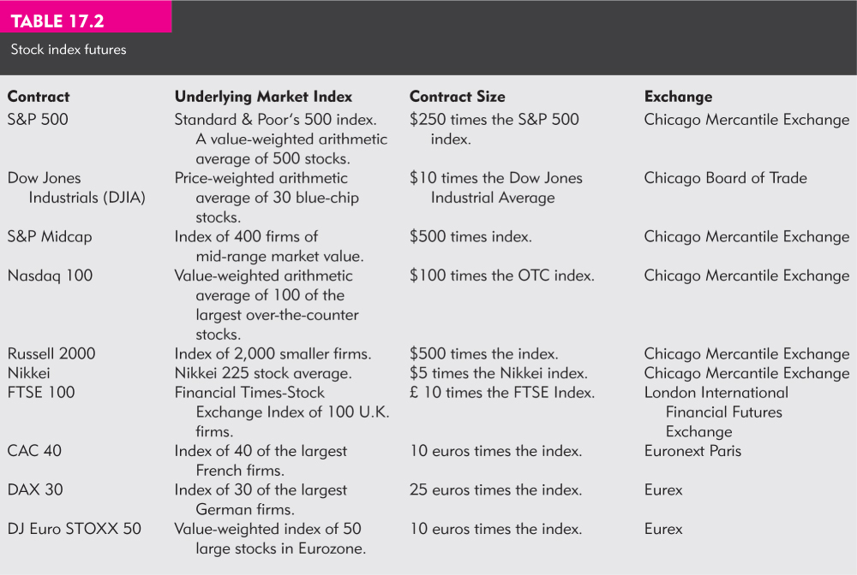
Stock Index Futures

Slide 28
Creating Synthetic Stock Positions
Synthetic stock purchase
Purchase of stock index futures instead of actual shares of stock
Allows frequent trading at low cost, especially useful for foreign investments
Classic market timing strategy involves switching between Treasury bills and stocks based on market conditions.
It is cheaper to buy Treasury bills and then shift stock market exposure by buying and selling stock index futures.
Notes:
It is cheaper to buy Treasury bills and then shift stock market exposure by buying and selling stock index futures. In this strategy the investor is changing the relative weights on the riskless and risky asset.

Slide 29
Index Arbitrage
Exploiting mispricing between underlying stocks and the futures index contract
Futures Price too high:
Short the futures and buy the underlying stocks
Futures price too low:
Long the futures and short sell the underlying stocks
Difficult to do in practice
Transactions costs are often too large,
Trades must be done simultaneously
Any electronic trading platform assists in rapid trade execution
ETFs available on indices

Slide 30
Other Financial Futures Contracts
Foreign Currency
Forward contracts
Currency markets are the largest markets in the world,
Forward contracts are available from large banks,
Used extensively by firms to hedge foreign currency transactions.
Futures contracts are available for major currencies at most of the key markets.
March, June, September and December delivery contracts are available.
Notes:
This is a good point to remind the class of the differences in forwards and futures. Forwards are negotiated, face counterparty credit risk which may require posting collateral, are not marked to market and are generally not liquid. However if a corporation is a good customer of the bank issuing the forward contract the bank may cancel the contract at the customer’s request.

Slide 31
Foreign exchange risk
Foreign exchange risk is the risk that the value of a future receipt or obligation will change due to a change in foreign exchange rates.
Because these international transactions span time, foreign exchange risk can arise.
Foreign exchange shift
Changes in tastes for domestic and foreign products in the nation and abroad
Different growth and inflation rates in different nations
Changes in relative rates of interest
Changing expectations

Slide 32
Thank you for the attention!
Any Questions?

